Slide 1
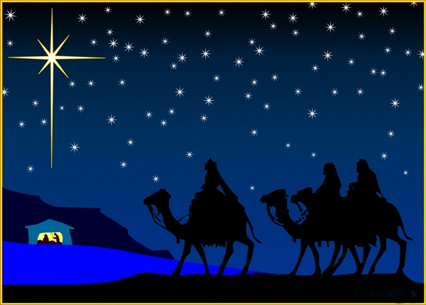
Unexpected visitors from the East
Matthew 2:1-12

Slide 2
Unexpected visitors from the East
Matthew 2:1-12
1. Fake news!

Slide 3
Unexpected visitors from the East
Matthew 2:1-12
Fake news!
Why three?

Slide 4
Unexpected visitors from the East
Matthew 2:1-12
Fake news!
Why three?
Caravan

Slide 5
Unexpected visitors from the East
Matthew 2:1-12
Fake news!
Why three?
Caravan
Went to his house (2:11)

Slide 6
Unexpected visitors from the East
Matthew 2:1-12
Fake news!
Why three?
Caravan
Went to his house (2:11)
Poor people’s offering (Luke 2:24)

Slide 7
Unexpected visitors from the East
Matthew 2:1-12
Fake news!
Why three?
Caravan
Went to his house (2:11)
Poor people’s offering (Luke 2:24)
Magi arrived after Jerusalem visit

Slide 8
Unexpected visitors from the East
Matthew 2:1-12
Fake news!
The facts!

Slide 9
Unexpected visitors from the East
Matthew 2:1-12
Fake news!
The facts!
Important people

Slide 10
Unexpected visitors from the East
Matthew 2:1-12
Fake news!
The facts!
Important people
Followed a star

Slide 11
Unexpected visitors from the East
Matthew 2:1-12
Fake news!
The facts!
Important people
Followed a star
Aware of Balaam’s prophecy? (Num.24:17)

Slide 12
Unexpected visitors from the East
Matthew 2:1-12
Fake news!
The facts!
Lessons from the Magi

Slide 13
Unexpected visitors from the East
Matthew 2:1-12
Fake news!
The facts!
Lessons from the Magi
Jesus’ birth = part of God’s plan

Slide 14
Unexpected visitors from the East
Matthew 2:1-12
Fake news!
The facts!
Lessons from the Magi
Jesus’ birth = part of God’s plan
Five elements necessary for identification

Slide 15
Unexpected visitors from the East
Matthew 2:1-12
Fake news!
The facts!
Lessons from the Magi
Jesus’ birth = part of God’s plan
Five elements necessary for identification
Matthew gives us three points

Slide 16
Unexpected visitors from the East
Matthew 2:1-12
Fake news!
The facts!
Lessons from the Magi
Jesus’ birth = part of God’s plan
Five elements necessary for identification
Matthew gives us three points
Hundreds of prophecies point to Jesus

Slide 17
Unexpected visitors from the East
Matthew 2:1-12
Fake news!
The facts!
Lessons from the Magi
Jesus’ birth = part of God’s plan
Five elements necessary for identification
Matthew gives us three points
Hundreds of prophecies point to Jesus
Jesus didn’t only come for the Jews

Slide 18
Unexpected visitors from the East
Matthew 2:1-12
Fake news!
The facts!
Lessons from the Magi
Jesus’ birth = part of God’s plan
Five elements necessary for identification
Matthew gives us three points
Hundreds of prophecies point to Jesus
Jesus didn’t only come for the Jews
True faith requires action

Slide 19
Unexpected visitors from the East
Matthew 2:1-12
Fake news!
The facts!
Lessons from the Magi
Jesus’ birth = part of God’s plan
Five elements necessary for identification
Matthew gives us three points
Hundreds of prophecies point to Jesus
Jesus didn’t only come for the Jews
True faith requires action
We too need to respond

Slide 20
Unexpected visitors from the East
Matthew 2:1-12
Fake news!
The facts!
Lessons from the Magi
Jesus’ birth = part of God’s plan
Five elements necessary for identification
Matthew gives us three points
Hundreds of prophecies point to Jesus
Jesus didn’t only come for the Jews
True faith requires action
We too need to respond
Jesus deserves our best

Slide 21
Unexpected visitors from the East
Matthew 2:1-12
Fake news!
The facts!
Lessons from the Magi
Jesus’ birth = part of God’s plan
Five elements necessary for identification
Matthew gives us three points
Hundreds of prophecies point to Jesus
Jesus didn’t only come for the Jews
True faith requires action
We too need to respond
Jesus deserves our best
Which gift list for Jesus?

